Slide 1
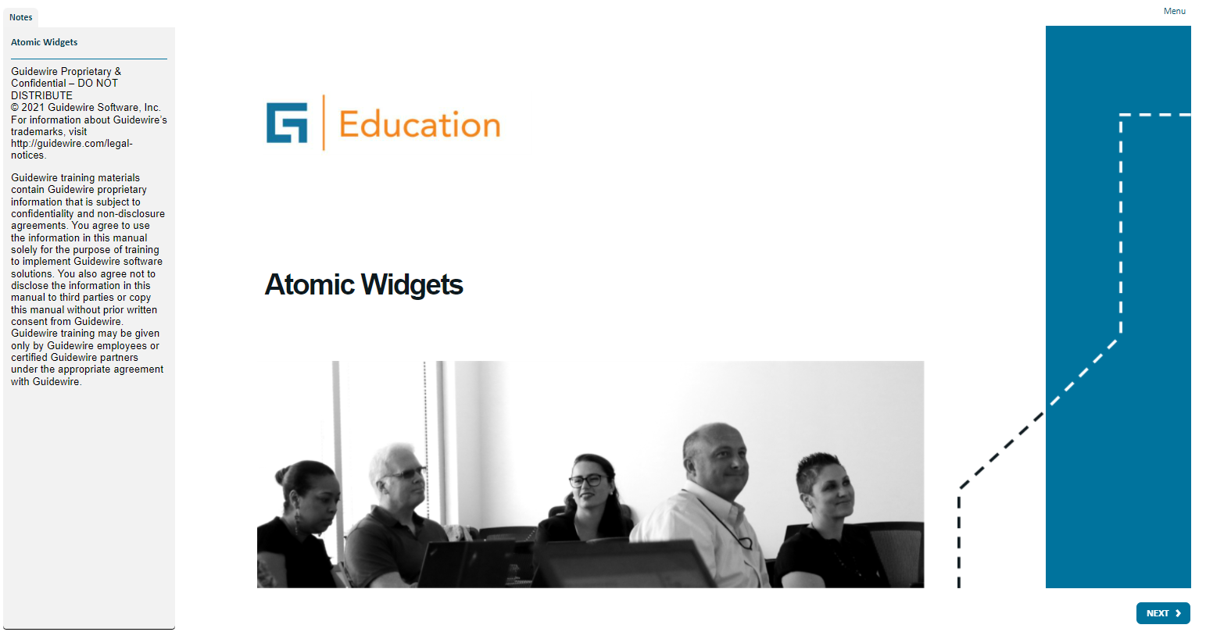
Notes:
A widget is a graphical user interface element responsible for interacting with the user. "Widget" is a Java specific, industry term. Widgets maintain and draw their state using some combination of graphical drawing operations. Using the mouse or the keyboard, the user can change the state of a widget. When a state change occurs, whether initiated by the user or the application code, widgets redraw to show the new state.
Both Widget and Location are conceptual representations in this diagram. There are no <Widget /> or <Location /> elements. Atomic Widget is also a conceptual representation. There is no <AtomicWidget /> element.
A location is a place to which you can navigate in the interface. Locations are used primarily to provide a hierarchical organization of the interface elements, and to assist with navigation. PCF elements that are consider locations include pages, wizards, worksheets, forwards, and location groups.
A widget is a PCF element that a Guidewire application renders into an HTML object. Buttons, menus, text boxes, and dropdown lists are all examples of PCF elements that are considered widgets. Some widgets that are not visually presented in the web browser, but are rendered as an HTML object, such as a hidden input.

Slide 2
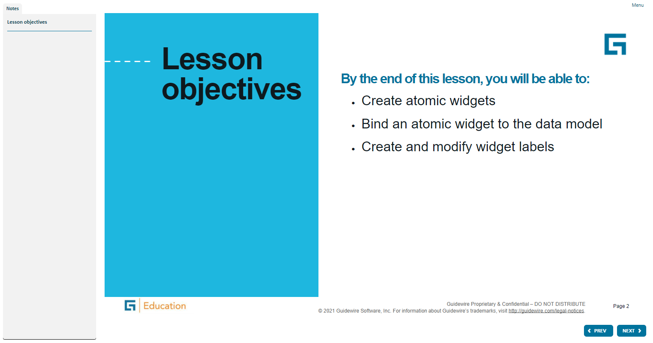
Notes:
A widget is a graphical user interface element responsible for interacting with the user. "Widget" is a Java specific, industry term. Widgets maintain and draw their state using some combination of graphical drawing operations. Using the mouse or the keyboard, the user can change the state of a widget. When a state change occurs, whether initiated by the user or the application code, widgets redraw to show the new state.
Both Widget and Location are conceptual representations in this diagram. There are no <Widget /> or <Location /> elements. Atomic Widget is also a conceptual representation. There is no <AtomicWidget /> element.
A location is a place to which you can navigate in the interface. Locations are used primarily to provide a hierarchical organization of the interface elements, and to assist with navigation. PCF elements that are consider locations include pages, wizards, worksheets, forwards, and location groups.
A widget is a PCF element that a Guidewire application renders into an HTML object. Buttons, menus, text boxes, and dropdown lists are all examples of PCF elements that are considered widgets. Some widgets that are not visually presented in the web browser, but are rendered as an HTML object, such as a hidden input.

Slide 3
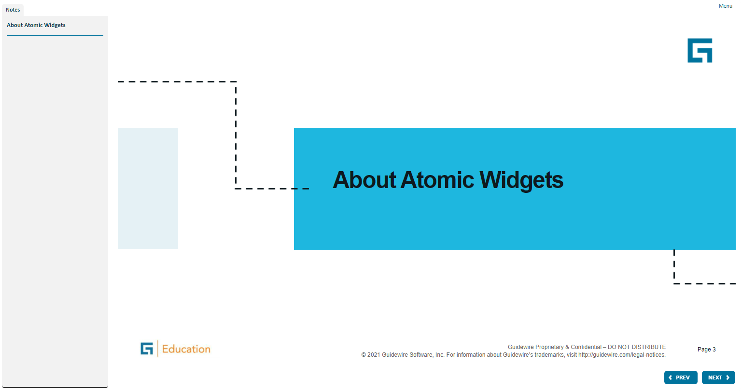
Notes:
A widget is a graphical user interface element responsible for interacting with the user. "Widget" is a Java specific, industry term. Widgets maintain and draw their state using some combination of graphical drawing operations. Using the mouse or the keyboard, the user can change the state of a widget. When a state change occurs, whether initiated by the user or the application code, widgets redraw to show the new state.
Both Widget and Location are conceptual representations in this diagram. There are no <Widget /> or <Location /> elements. Atomic Widget is also a conceptual representation. There is no <AtomicWidget /> element.
A location is a place to which you can navigate in the interface. Locations are used primarily to provide a hierarchical organization of the interface elements, and to assist with navigation. PCF elements that are consider locations include pages, wizards, worksheets, forwards, and location groups.
A widget is a PCF element that a Guidewire application renders into an HTML object. Buttons, menus, text boxes, and dropdown lists are all examples of PCF elements that are considered widgets. Some widgets that are not visually presented in the web browser, but are rendered as an HTML object, such as a hidden input.

Slide 4
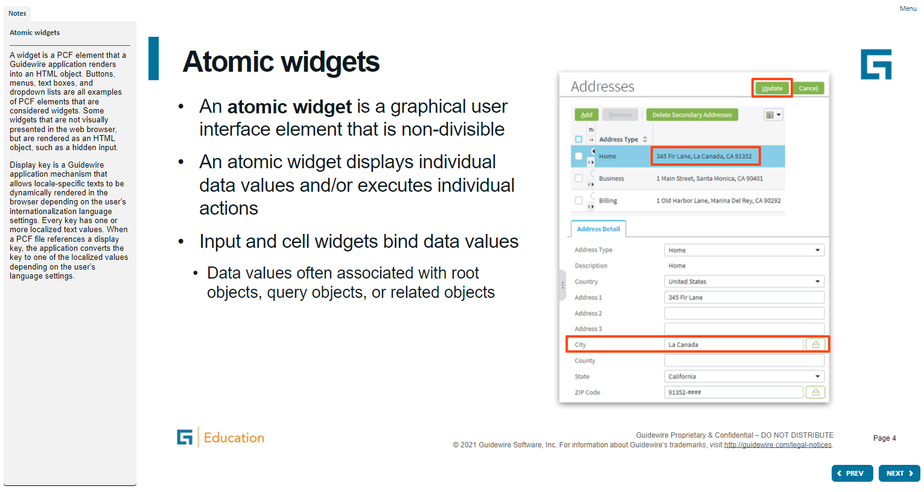
Notes:
A widget is a graphical user interface element responsible for interacting with the user. "Widget" is a Java specific, industry term. Widgets maintain and draw their state using some combination of graphical drawing operations. Using the mouse or the keyboard, the user can change the state of a widget. When a state change occurs, whether initiated by the user or the application code, widgets redraw to show the new state.
Both Widget and Location are conceptual representations in this diagram. There are no <Widget /> or <Location /> elements. Atomic Widget is also a conceptual representation. There is no <AtomicWidget /> element.
A location is a place to which you can navigate in the interface. Locations are used primarily to provide a hierarchical organization of the interface elements, and to assist with navigation. PCF elements that are consider locations include pages, wizards, worksheets, forwards, and location groups.
A widget is a PCF element that a Guidewire application renders into an HTML object. Buttons, menus, text boxes, and dropdown lists are all examples of PCF elements that are considered widgets. Some widgets that are not visually presented in the web browser, but are rendered as an HTML object, such as a hidden input.

Slide 5
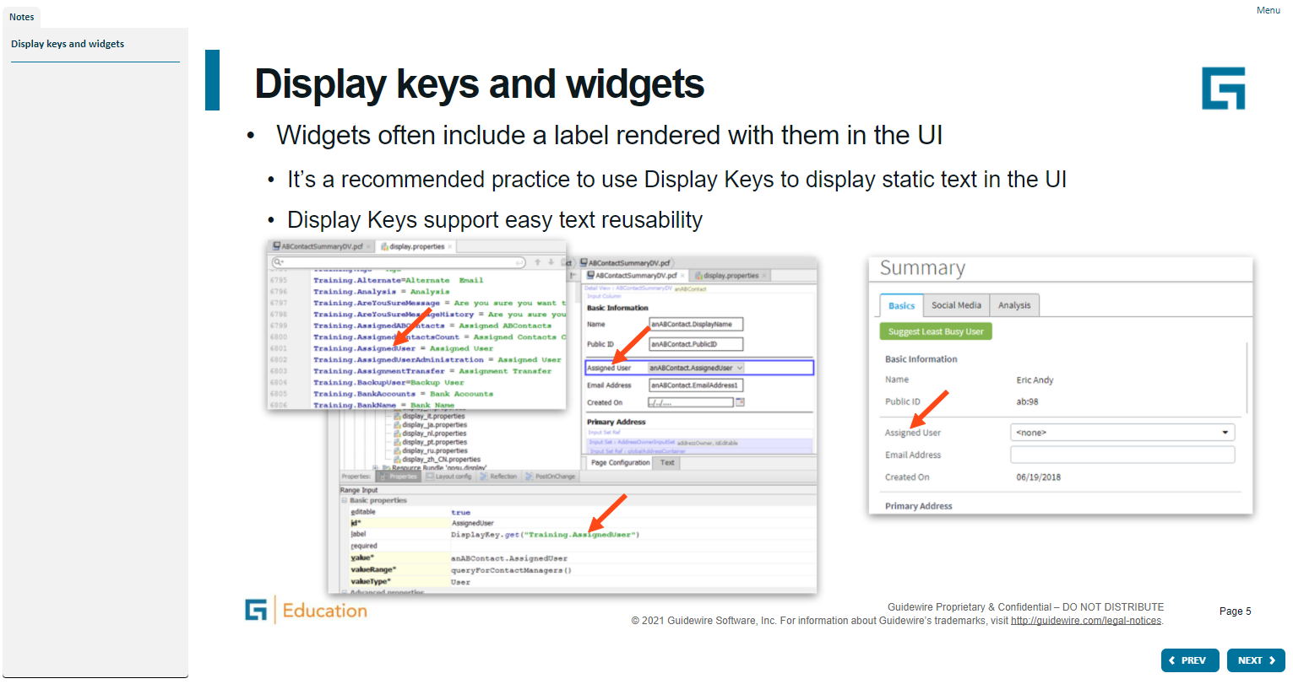
Notes:
A widget is a graphical user interface element responsible for interacting with the user. "Widget" is a Java specific, industry term. Widgets maintain and draw their state using some combination of graphical drawing operations. Using the mouse or the keyboard, the user can change the state of a widget. When a state change occurs, whether initiated by the user or the application code, widgets redraw to show the new state.
Both Widget and Location are conceptual representations in this diagram. There are no <Widget /> or <Location /> elements. Atomic Widget is also a conceptual representation. There is no <AtomicWidget /> element.
A location is a place to which you can navigate in the interface. Locations are used primarily to provide a hierarchical organization of the interface elements, and to assist with navigation. PCF elements that are consider locations include pages, wizards, worksheets, forwards, and location groups.
A widget is a PCF element that a Guidewire application renders into an HTML object. Buttons, menus, text boxes, and dropdown lists are all examples of PCF elements that are considered widgets. Some widgets that are not visually presented in the web browser, but are rendered as an HTML object, such as a hidden input.

Slide 6
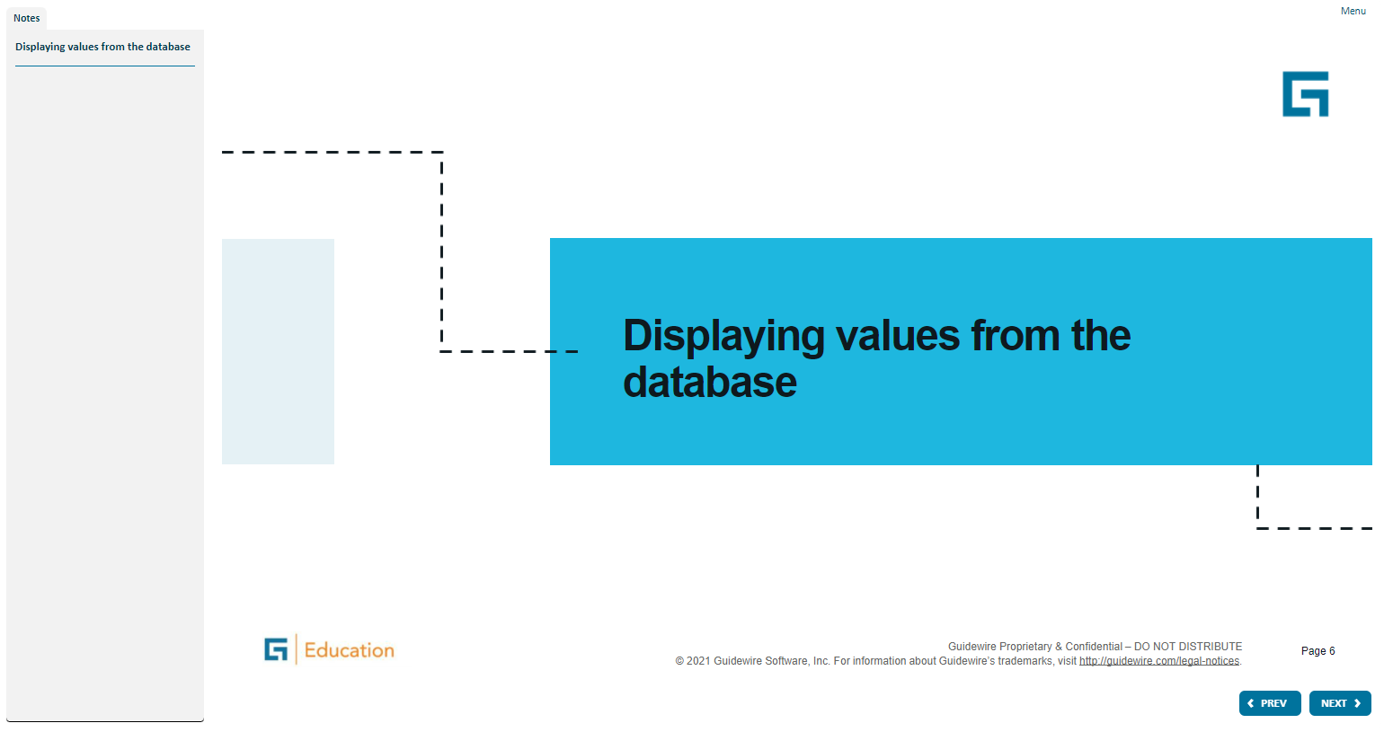
Notes:
A widget is a graphical user interface element responsible for interacting with the user. "Widget" is a Java specific, industry term. Widgets maintain and draw their state using some combination of graphical drawing operations. Using the mouse or the keyboard, the user can change the state of a widget. When a state change occurs, whether initiated by the user or the application code, widgets redraw to show the new state.
Both Widget and Location are conceptual representations in this diagram. There are no <Widget /> or <Location /> elements. Atomic Widget is also a conceptual representation. There is no <AtomicWidget /> element.
A location is a place to which you can navigate in the interface. Locations are used primarily to provide a hierarchical organization of the interface elements, and to assist with navigation. PCF elements that are consider locations include pages, wizards, worksheets, forwards, and location groups.
A widget is a PCF element that a Guidewire application renders into an HTML object. Buttons, menus, text boxes, and dropdown lists are all examples of PCF elements that are considered widgets. Some widgets that are not visually presented in the web browser, but are rendered as an HTML object, such as a hidden input.

Slide 7
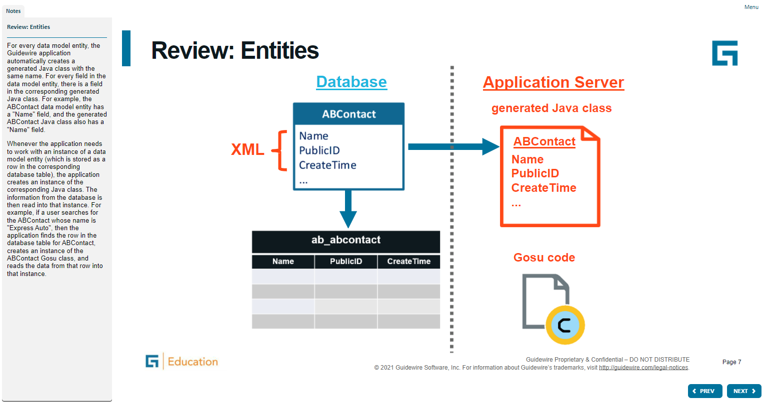
Notes:
A widget is a graphical user interface element responsible for interacting with the user. "Widget" is a Java specific, industry term. Widgets maintain and draw their state using some combination of graphical drawing operations. Using the mouse or the keyboard, the user can change the state of a widget. When a state change occurs, whether initiated by the user or the application code, widgets redraw to show the new state.
Both Widget and Location are conceptual representations in this diagram. There are no <Widget /> or <Location /> elements. Atomic Widget is also a conceptual representation. There is no <AtomicWidget /> element.
A location is a place to which you can navigate in the interface. Locations are used primarily to provide a hierarchical organization of the interface elements, and to assist with navigation. PCF elements that are consider locations include pages, wizards, worksheets, forwards, and location groups.
A widget is a PCF element that a Guidewire application renders into an HTML object. Buttons, menus, text boxes, and dropdown lists are all examples of PCF elements that are considered widgets. Some widgets that are not visually presented in the web browser, but are rendered as an HTML object, such as a hidden input.

Slide 8
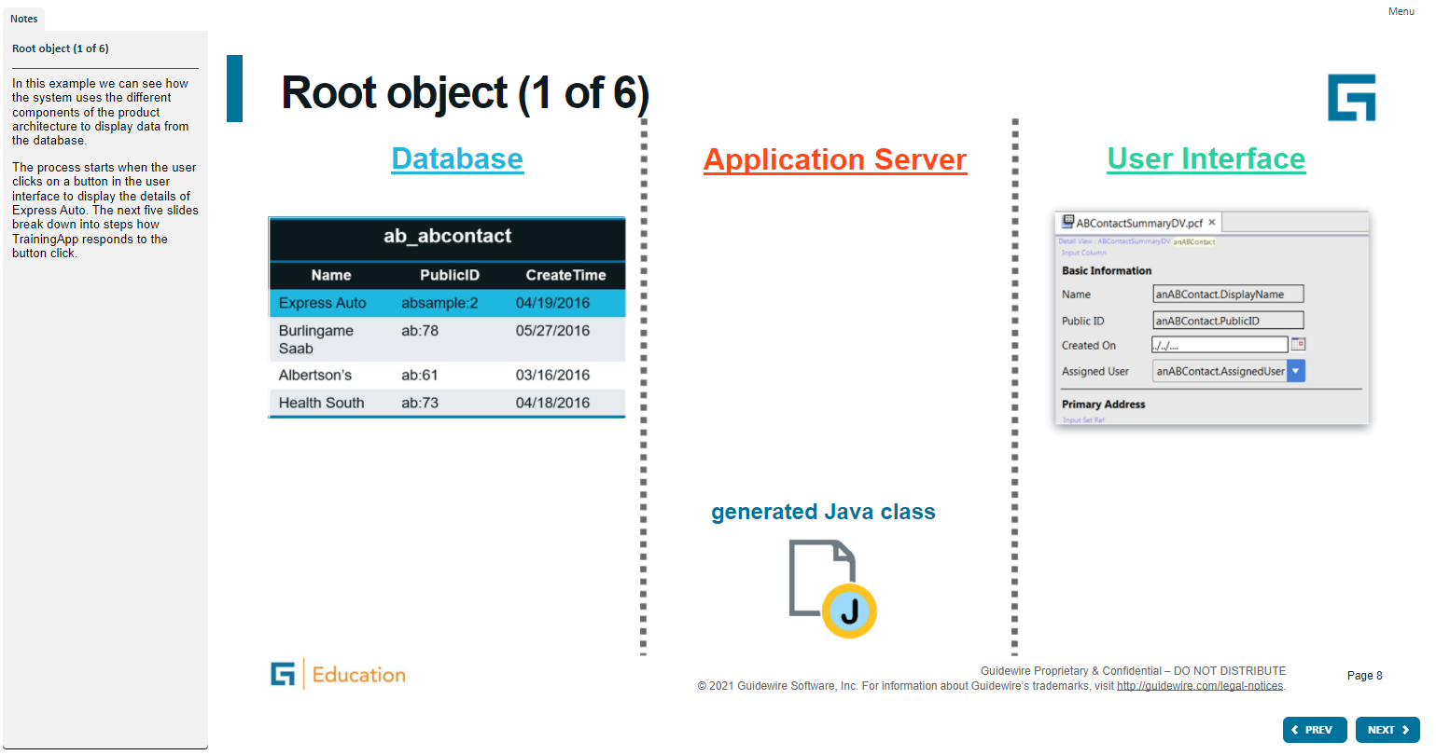
Notes:
A widget is a graphical user interface element responsible for interacting with the user. "Widget" is a Java specific, industry term. Widgets maintain and draw their state using some combination of graphical drawing operations. Using the mouse or the keyboard, the user can change the state of a widget. When a state change occurs, whether initiated by the user or the application code, widgets redraw to show the new state.
Both Widget and Location are conceptual representations in this diagram. There are no <Widget /> or <Location /> elements. Atomic Widget is also a conceptual representation. There is no <AtomicWidget /> element.
A location is a place to which you can navigate in the interface. Locations are used primarily to provide a hierarchical organization of the interface elements, and to assist with navigation. PCF elements that are consider locations include pages, wizards, worksheets, forwards, and location groups.
A widget is a PCF element that a Guidewire application renders into an HTML object. Buttons, menus, text boxes, and dropdown lists are all examples of PCF elements that are considered widgets. Some widgets that are not visually presented in the web browser, but are rendered as an HTML object, such as a hidden input.

Slide 9
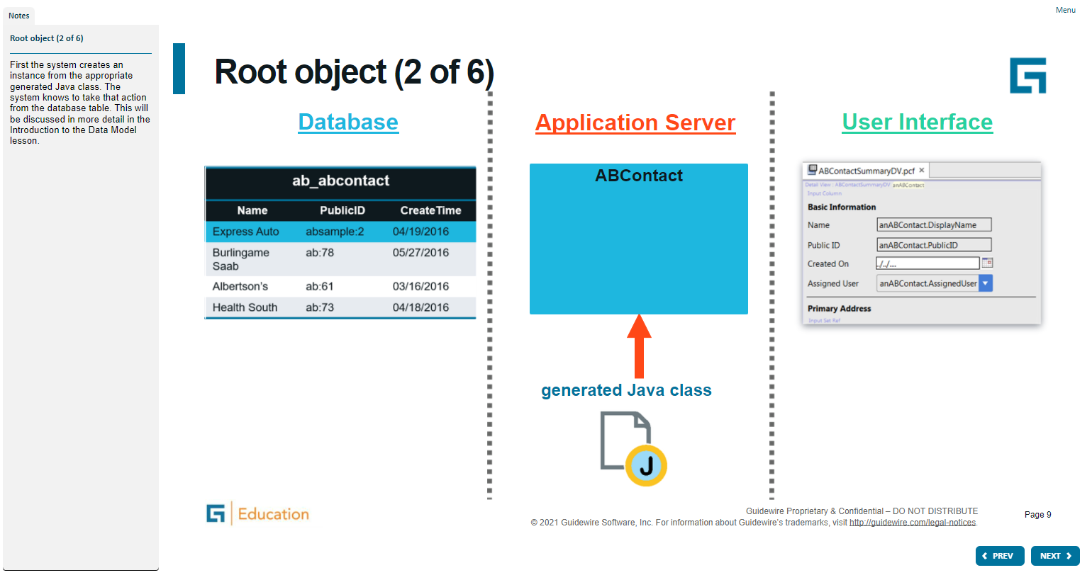
Notes:
A widget is a graphical user interface element responsible for interacting with the user. "Widget" is a Java specific, industry term. Widgets maintain and draw their state using some combination of graphical drawing operations. Using the mouse or the keyboard, the user can change the state of a widget. When a state change occurs, whether initiated by the user or the application code, widgets redraw to show the new state.
Both Widget and Location are conceptual representations in this diagram. There are no <Widget /> or <Location /> elements. Atomic Widget is also a conceptual representation. There is no <AtomicWidget /> element.
A location is a place to which you can navigate in the interface. Locations are used primarily to provide a hierarchical organization of the interface elements, and to assist with navigation. PCF elements that are consider locations include pages, wizards, worksheets, forwards, and location groups.
A widget is a PCF element that a Guidewire application renders into an HTML object. Buttons, menus, text boxes, and dropdown lists are all examples of PCF elements that are considered widgets. Some widgets that are not visually presented in the web browser, but are rendered as an HTML object, such as a hidden input.

Slide 10
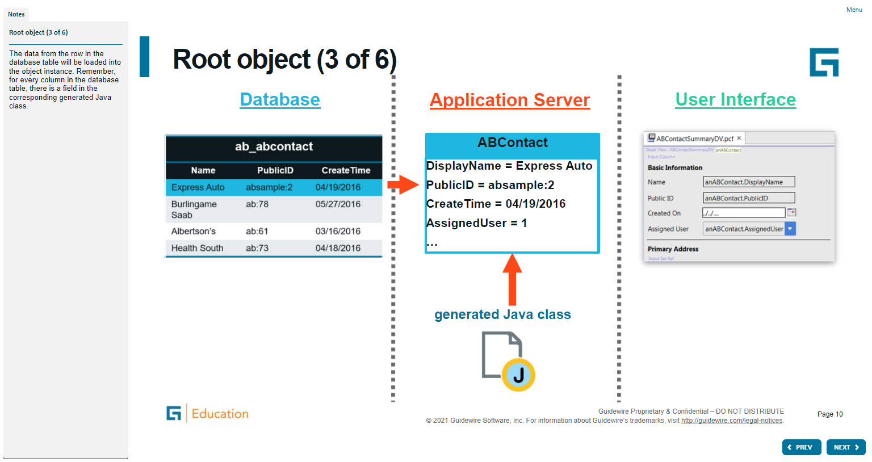
Notes:
A widget is a graphical user interface element responsible for interacting with the user. "Widget" is a Java specific, industry term. Widgets maintain and draw their state using some combination of graphical drawing operations. Using the mouse or the keyboard, the user can change the state of a widget. When a state change occurs, whether initiated by the user or the application code, widgets redraw to show the new state.
Both Widget and Location are conceptual representations in this diagram. There are no <Widget /> or <Location /> elements. Atomic Widget is also a conceptual representation. There is no <AtomicWidget /> element.
A location is a place to which you can navigate in the interface. Locations are used primarily to provide a hierarchical organization of the interface elements, and to assist with navigation. PCF elements that are consider locations include pages, wizards, worksheets, forwards, and location groups.
A widget is a PCF element that a Guidewire application renders into an HTML object. Buttons, menus, text boxes, and dropdown lists are all examples of PCF elements that are considered widgets. Some widgets that are not visually presented in the web browser, but are rendered as an HTML object, such as a hidden input.

Slide 11
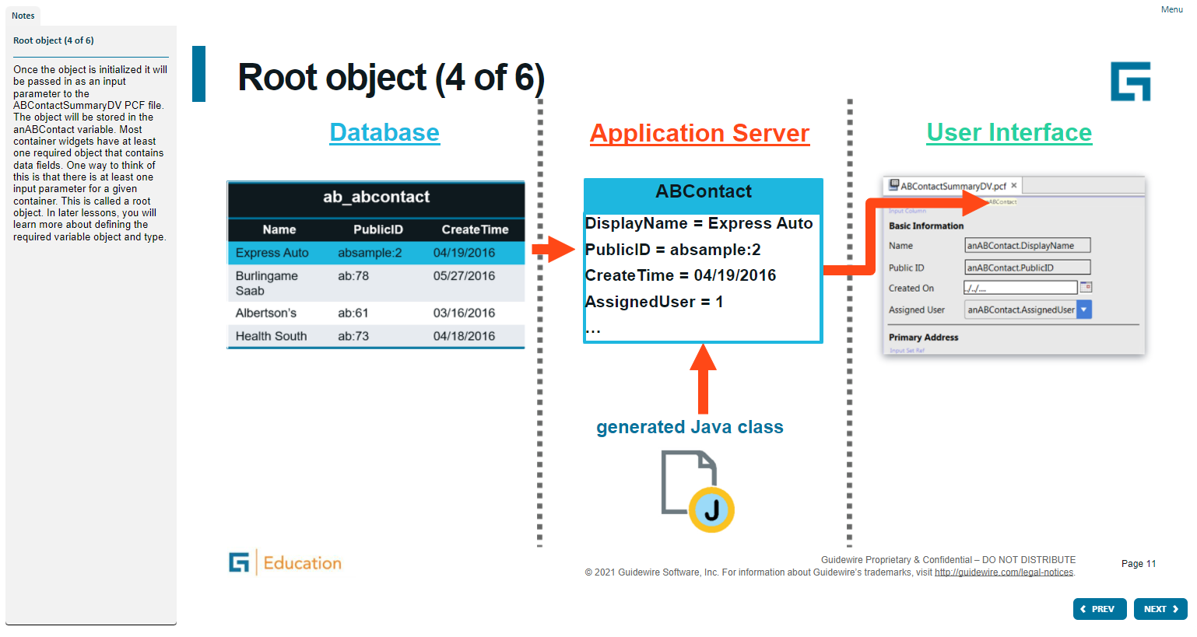
Notes:
A widget is a graphical user interface element responsible for interacting with the user. "Widget" is a Java specific, industry term. Widgets maintain and draw their state using some combination of graphical drawing operations. Using the mouse or the keyboard, the user can change the state of a widget. When a state change occurs, whether initiated by the user or the application code, widgets redraw to show the new state.
Both Widget and Location are conceptual representations in this diagram. There are no <Widget /> or <Location /> elements. Atomic Widget is also a conceptual representation. There is no <AtomicWidget /> element.
A location is a place to which you can navigate in the interface. Locations are used primarily to provide a hierarchical organization of the interface elements, and to assist with navigation. PCF elements that are consider locations include pages, wizards, worksheets, forwards, and location groups.
A widget is a PCF element that a Guidewire application renders into an HTML object. Buttons, menus, text boxes, and dropdown lists are all examples of PCF elements that are considered widgets. Some widgets that are not visually presented in the web browser, but are rendered as an HTML object, such as a hidden input.

Slide 12
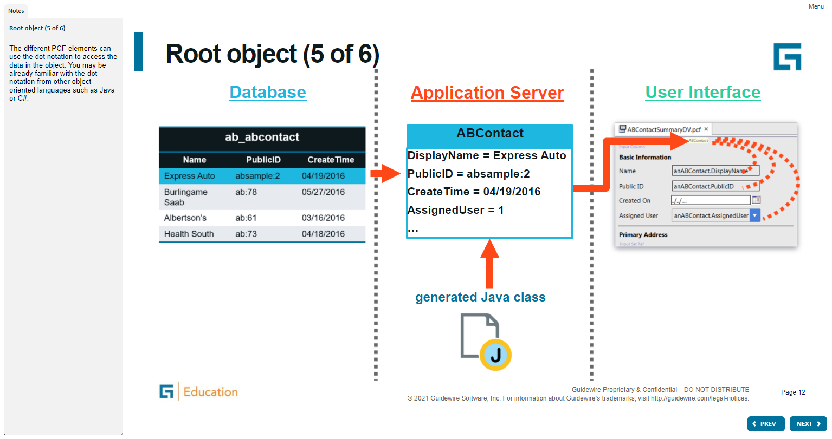
Notes:
A widget is a graphical user interface element responsible for interacting with the user. "Widget" is a Java specific, industry term. Widgets maintain and draw their state using some combination of graphical drawing operations. Using the mouse or the keyboard, the user can change the state of a widget. When a state change occurs, whether initiated by the user or the application code, widgets redraw to show the new state.
Both Widget and Location are conceptual representations in this diagram. There are no <Widget /> or <Location /> elements. Atomic Widget is also a conceptual representation. There is no <AtomicWidget /> element.
A location is a place to which you can navigate in the interface. Locations are used primarily to provide a hierarchical organization of the interface elements, and to assist with navigation. PCF elements that are consider locations include pages, wizards, worksheets, forwards, and location groups.
A widget is a PCF element that a Guidewire application renders into an HTML object. Buttons, menus, text boxes, and dropdown lists are all examples of PCF elements that are considered widgets. Some widgets that are not visually presented in the web browser, but are rendered as an HTML object, such as a hidden input.

Slide 13
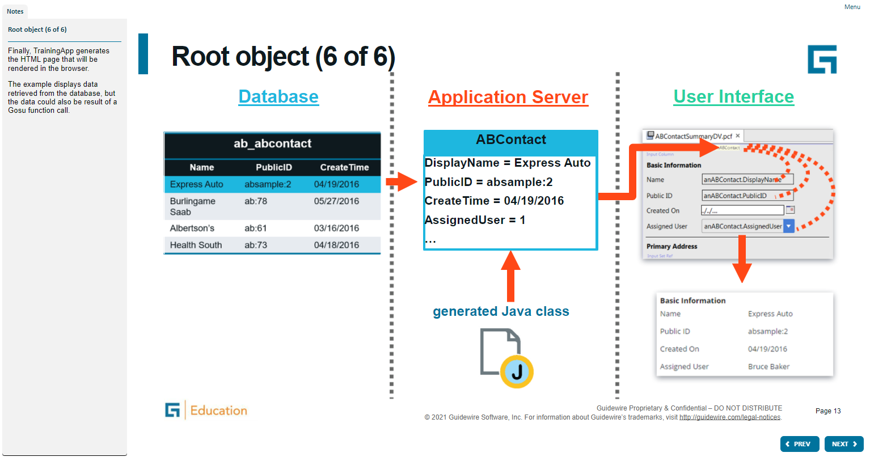
Notes:
A widget is a graphical user interface element responsible for interacting with the user. "Widget" is a Java specific, industry term. Widgets maintain and draw their state using some combination of graphical drawing operations. Using the mouse or the keyboard, the user can change the state of a widget. When a state change occurs, whether initiated by the user or the application code, widgets redraw to show the new state.
Both Widget and Location are conceptual representations in this diagram. There are no <Widget /> or <Location /> elements. Atomic Widget is also a conceptual representation. There is no <AtomicWidget /> element.
A location is a place to which you can navigate in the interface. Locations are used primarily to provide a hierarchical organization of the interface elements, and to assist with navigation. PCF elements that are consider locations include pages, wizards, worksheets, forwards, and location groups.
A widget is a PCF element that a Guidewire application renders into an HTML object. Buttons, menus, text boxes, and dropdown lists are all examples of PCF elements that are considered widgets. Some widgets that are not visually presented in the web browser, but are rendered as an HTML object, such as a hidden input.

Slide 14
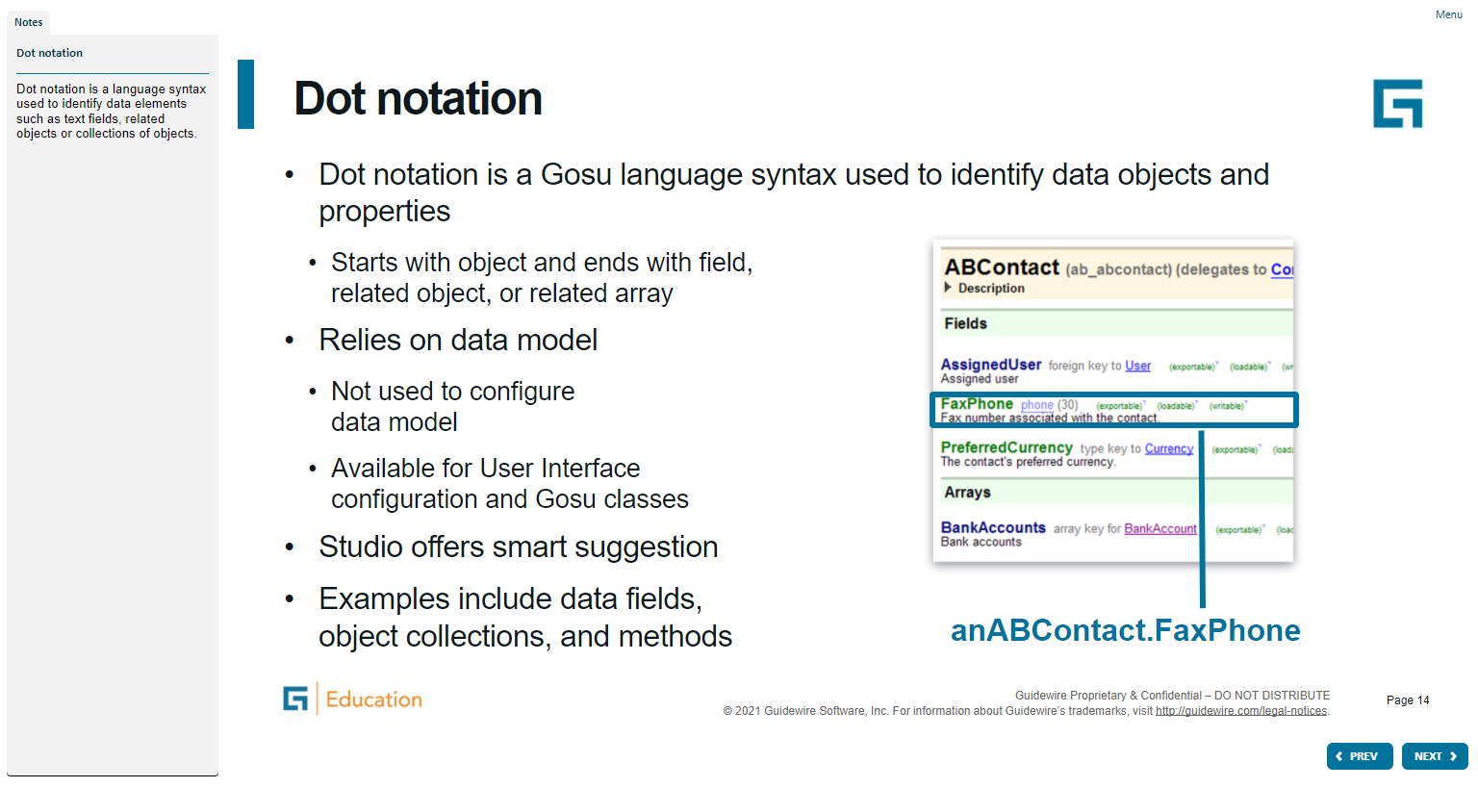
Notes:
A widget is a graphical user interface element responsible for interacting with the user. "Widget" is a Java specific, industry term. Widgets maintain and draw their state using some combination of graphical drawing operations. Using the mouse or the keyboard, the user can change the state of a widget. When a state change occurs, whether initiated by the user or the application code, widgets redraw to show the new state.
Both Widget and Location are conceptual representations in this diagram. There are no <Widget /> or <Location /> elements. Atomic Widget is also a conceptual representation. There is no <AtomicWidget /> element.
A location is a place to which you can navigate in the interface. Locations are used primarily to provide a hierarchical organization of the interface elements, and to assist with navigation. PCF elements that are consider locations include pages, wizards, worksheets, forwards, and location groups.
A widget is a PCF element that a Guidewire application renders into an HTML object. Buttons, menus, text boxes, and dropdown lists are all examples of PCF elements that are considered widgets. Some widgets that are not visually presented in the web browser, but are rendered as an HTML object, such as a hidden input.

Slide 15
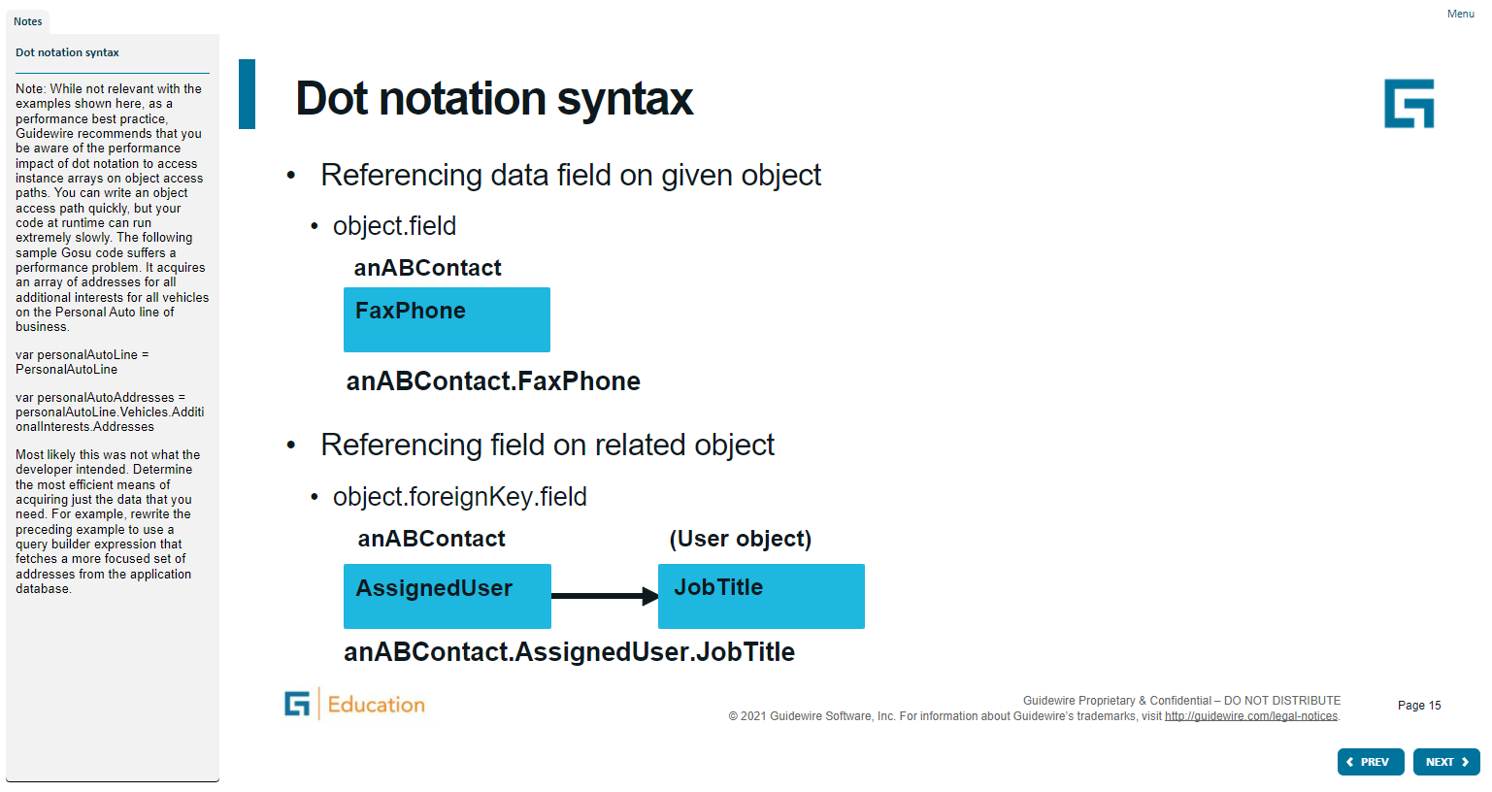
Notes:
A widget is a graphical user interface element responsible for interacting with the user. "Widget" is a Java specific, industry term. Widgets maintain and draw their state using some combination of graphical drawing operations. Using the mouse or the keyboard, the user can change the state of a widget. When a state change occurs, whether initiated by the user or the application code, widgets redraw to show the new state.
Both Widget and Location are conceptual representations in this diagram. There are no <Widget /> or <Location /> elements. Atomic Widget is also a conceptual representation. There is no <AtomicWidget /> element.
A location is a place to which you can navigate in the interface. Locations are used primarily to provide a hierarchical organization of the interface elements, and to assist with navigation. PCF elements that are consider locations include pages, wizards, worksheets, forwards, and location groups.
A widget is a PCF element that a Guidewire application renders into an HTML object. Buttons, menus, text boxes, and dropdown lists are all examples of PCF elements that are considered widgets. Some widgets that are not visually presented in the web browser, but are rendered as an HTML object, such as a hidden input.

Slide 16
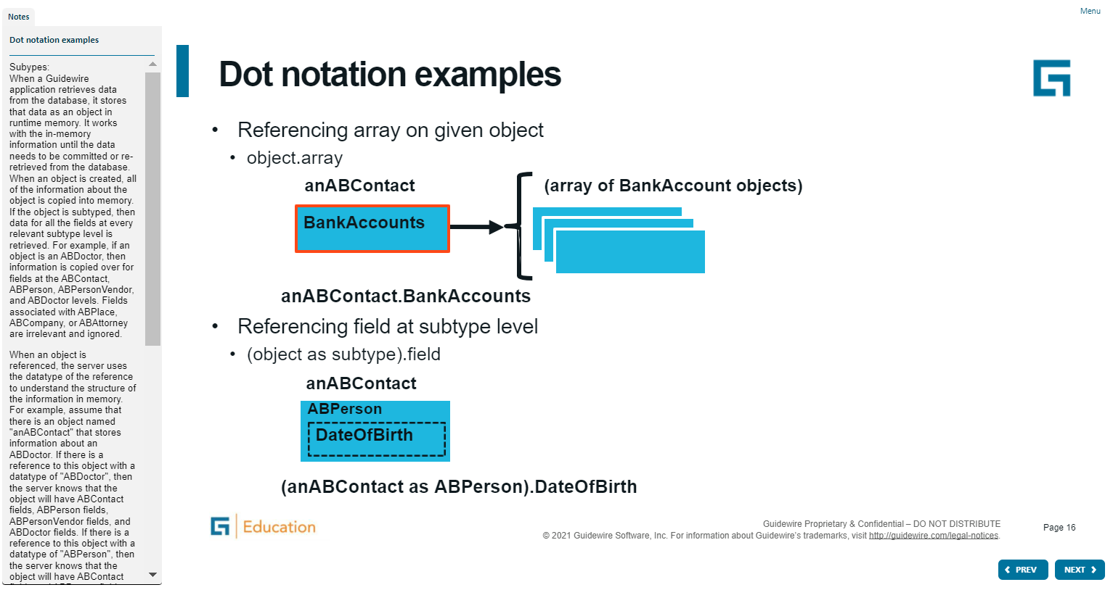
Notes:
A widget is a graphical user interface element responsible for interacting with the user. "Widget" is a Java specific, industry term. Widgets maintain and draw their state using some combination of graphical drawing operations. Using the mouse or the keyboard, the user can change the state of a widget. When a state change occurs, whether initiated by the user or the application code, widgets redraw to show the new state.
Both Widget and Location are conceptual representations in this diagram. There are no <Widget /> or <Location /> elements. Atomic Widget is also a conceptual representation. There is no <AtomicWidget /> element.
A location is a place to which you can navigate in the interface. Locations are used primarily to provide a hierarchical organization of the interface elements, and to assist with navigation. PCF elements that are consider locations include pages, wizards, worksheets, forwards, and location groups.
A widget is a PCF element that a Guidewire application renders into an HTML object. Buttons, menus, text boxes, and dropdown lists are all examples of PCF elements that are considered widgets. Some widgets that are not visually presented in the web browser, but are rendered as an HTML object, such as a hidden input.

Slide 17
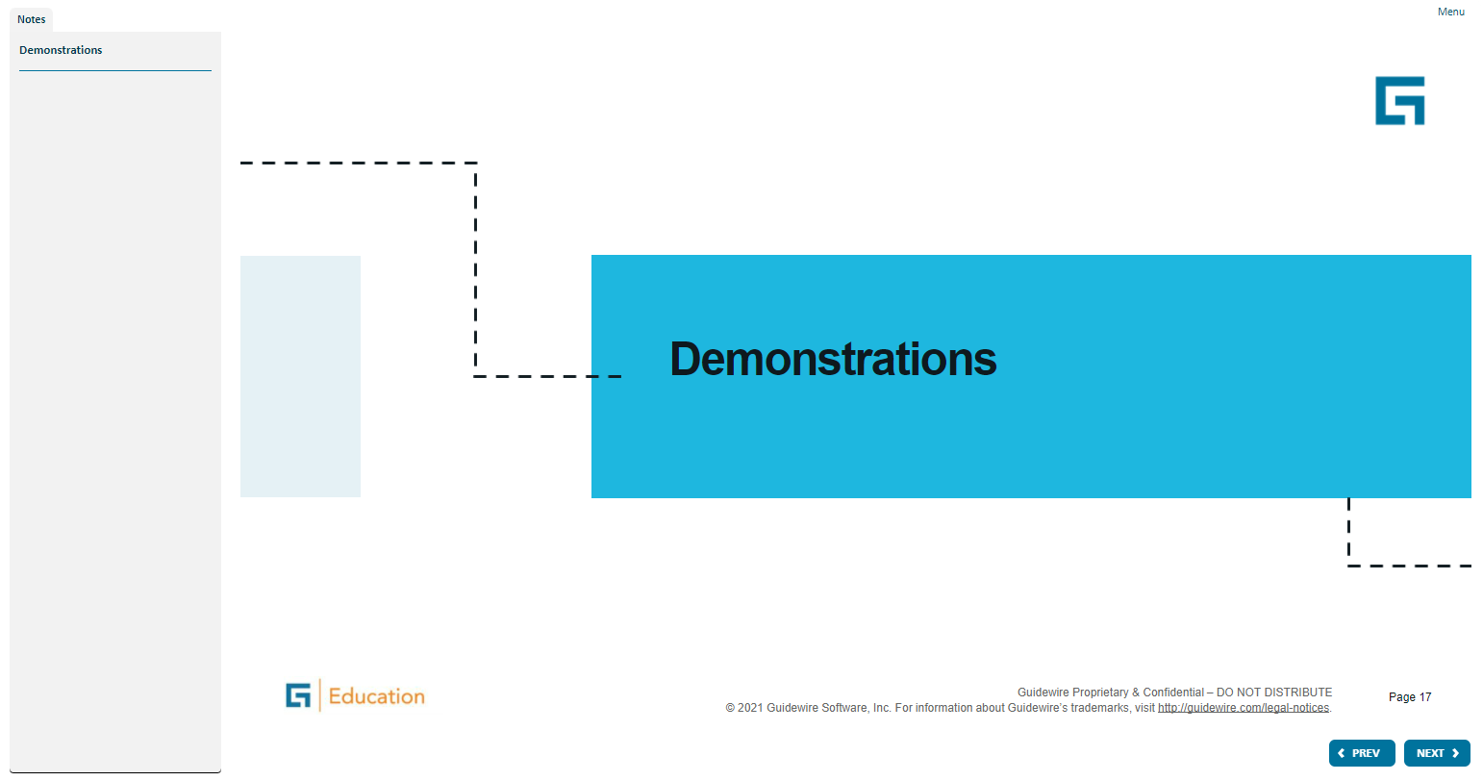
Notes:
A widget is a graphical user interface element responsible for interacting with the user. "Widget" is a Java specific, industry term. Widgets maintain and draw their state using some combination of graphical drawing operations. Using the mouse or the keyboard, the user can change the state of a widget. When a state change occurs, whether initiated by the user or the application code, widgets redraw to show the new state.
Both Widget and Location are conceptual representations in this diagram. There are no <Widget /> or <Location /> elements. Atomic Widget is also a conceptual representation. There is no <AtomicWidget /> element.
A location is a place to which you can navigate in the interface. Locations are used primarily to provide a hierarchical organization of the interface elements, and to assist with navigation. PCF elements that are consider locations include pages, wizards, worksheets, forwards, and location groups.
A widget is a PCF element that a Guidewire application renders into an HTML object. Buttons, menus, text boxes, and dropdown lists are all examples of PCF elements that are considered widgets. Some widgets that are not visually presented in the web browser, but are rendered as an HTML object, such as a hidden input.

Slide 18
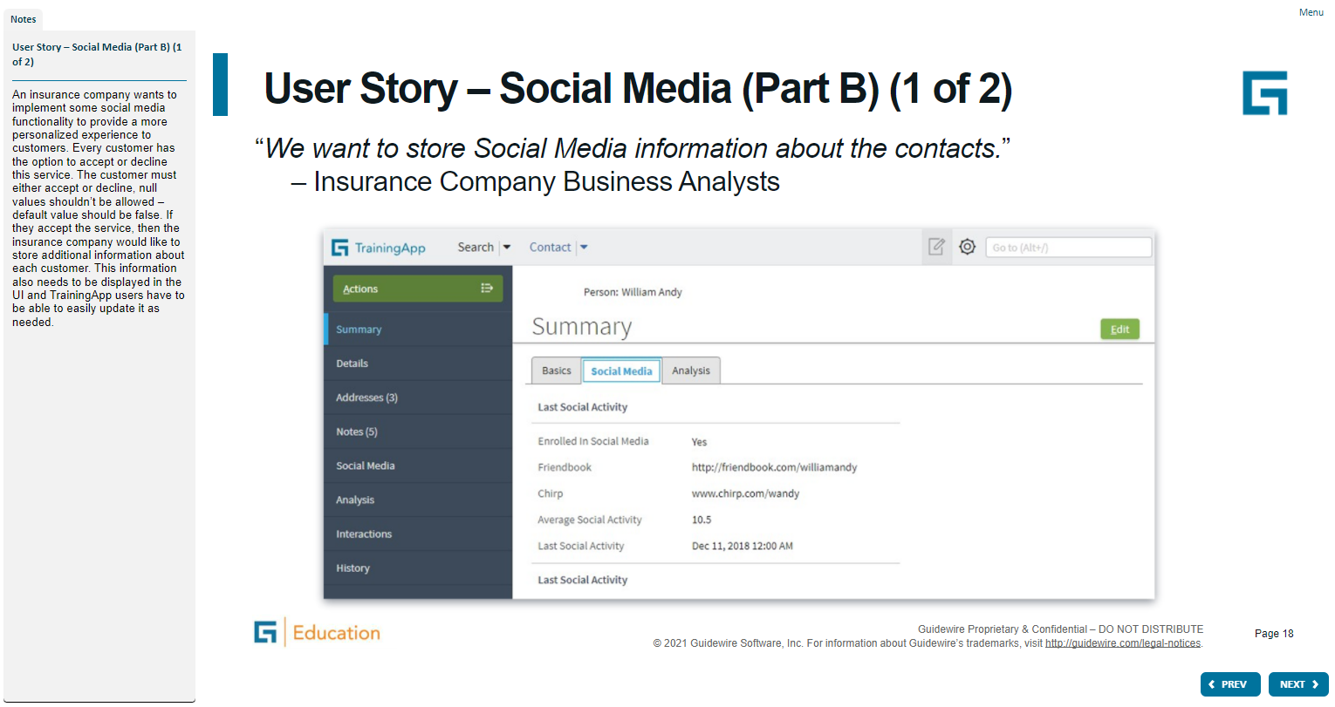
Notes:
A widget is a graphical user interface element responsible for interacting with the user. "Widget" is a Java specific, industry term. Widgets maintain and draw their state using some combination of graphical drawing operations. Using the mouse or the keyboard, the user can change the state of a widget. When a state change occurs, whether initiated by the user or the application code, widgets redraw to show the new state.
Both Widget and Location are conceptual representations in this diagram. There are no <Widget /> or <Location /> elements. Atomic Widget is also a conceptual representation. There is no <AtomicWidget /> element.
A location is a place to which you can navigate in the interface. Locations are used primarily to provide a hierarchical organization of the interface elements, and to assist with navigation. PCF elements that are consider locations include pages, wizards, worksheets, forwards, and location groups.
A widget is a PCF element that a Guidewire application renders into an HTML object. Buttons, menus, text boxes, and dropdown lists are all examples of PCF elements that are considered widgets. Some widgets that are not visually presented in the web browser, but are rendered as an HTML object, such as a hidden input.

Slide 19
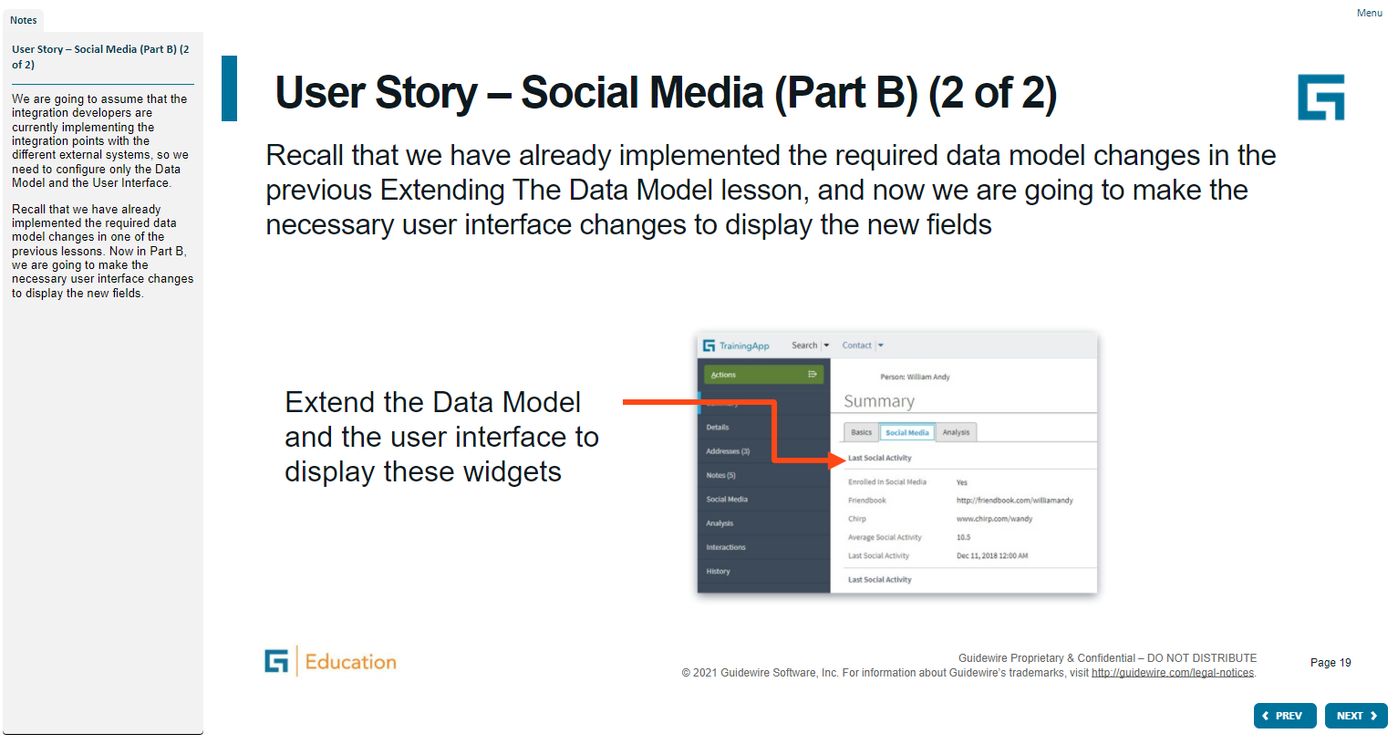
Notes:
A widget is a graphical user interface element responsible for interacting with the user. "Widget" is a Java specific, industry term. Widgets maintain and draw their state using some combination of graphical drawing operations. Using the mouse or the keyboard, the user can change the state of a widget. When a state change occurs, whether initiated by the user or the application code, widgets redraw to show the new state.
Both Widget and Location are conceptual representations in this diagram. There are no <Widget /> or <Location /> elements. Atomic Widget is also a conceptual representation. There is no <AtomicWidget /> element.
A location is a place to which you can navigate in the interface. Locations are used primarily to provide a hierarchical organization of the interface elements, and to assist with navigation. PCF elements that are consider locations include pages, wizards, worksheets, forwards, and location groups.
A widget is a PCF element that a Guidewire application renders into an HTML object. Buttons, menus, text boxes, and dropdown lists are all examples of PCF elements that are considered widgets. Some widgets that are not visually presented in the web browser, but are rendered as an HTML object, such as a hidden input.

Slide 20
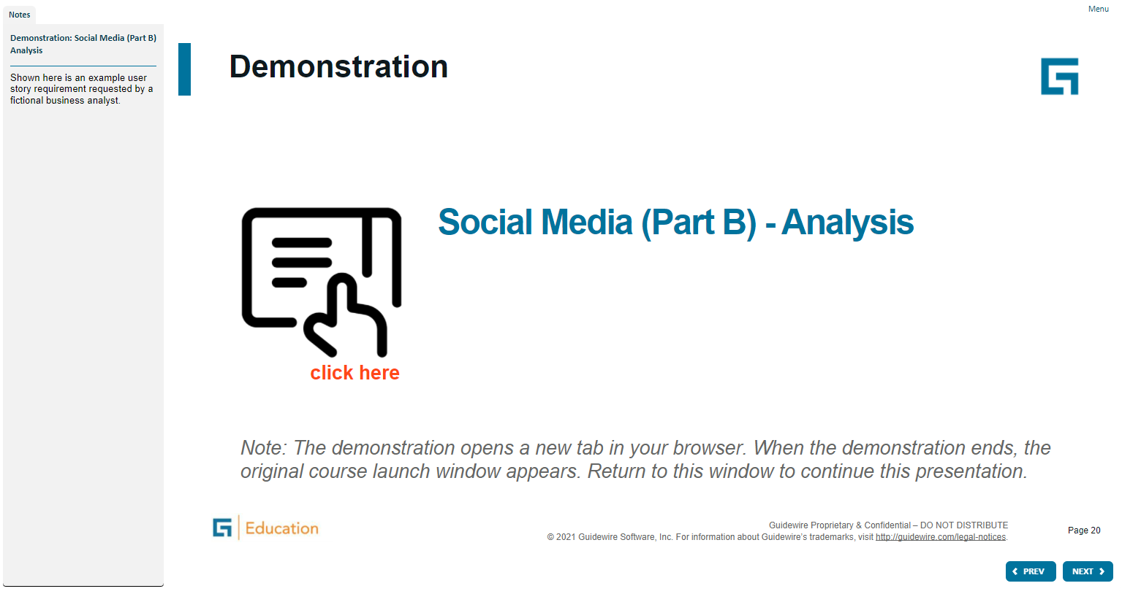
Notes:
A widget is a graphical user interface element responsible for interacting with the user. "Widget" is a Java specific, industry term. Widgets maintain and draw their state using some combination of graphical drawing operations. Using the mouse or the keyboard, the user can change the state of a widget. When a state change occurs, whether initiated by the user or the application code, widgets redraw to show the new state.
Both Widget and Location are conceptual representations in this diagram. There are no <Widget /> or <Location /> elements. Atomic Widget is also a conceptual representation. There is no <AtomicWidget /> element.
A location is a place to which you can navigate in the interface. Locations are used primarily to provide a hierarchical organization of the interface elements, and to assist with navigation. PCF elements that are consider locations include pages, wizards, worksheets, forwards, and location groups.
A widget is a PCF element that a Guidewire application renders into an HTML object. Buttons, menus, text boxes, and dropdown lists are all examples of PCF elements that are considered widgets. Some widgets that are not visually presented in the web browser, but are rendered as an HTML object, such as a hidden input.

Slide 21
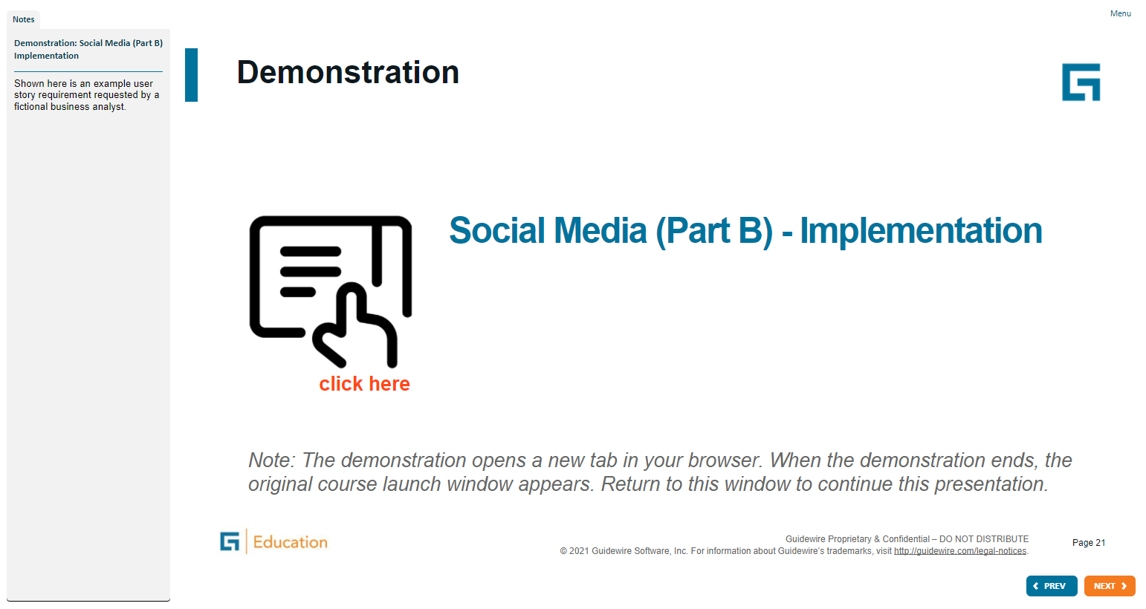
Notes:
A widget is a graphical user interface element responsible for interacting with the user. "Widget" is a Java specific, industry term. Widgets maintain and draw their state using some combination of graphical drawing operations. Using the mouse or the keyboard, the user can change the state of a widget. When a state change occurs, whether initiated by the user or the application code, widgets redraw to show the new state.
Both Widget and Location are conceptual representations in this diagram. There are no <Widget /> or <Location /> elements. Atomic Widget is also a conceptual representation. There is no <AtomicWidget /> element.
A location is a place to which you can navigate in the interface. Locations are used primarily to provide a hierarchical organization of the interface elements, and to assist with navigation. PCF elements that are consider locations include pages, wizards, worksheets, forwards, and location groups.
A widget is a PCF element that a Guidewire application renders into an HTML object. Buttons, menus, text boxes, and dropdown lists are all examples of PCF elements that are considered widgets. Some widgets that are not visually presented in the web browser, but are rendered as an HTML object, such as a hidden input.

Slide 22
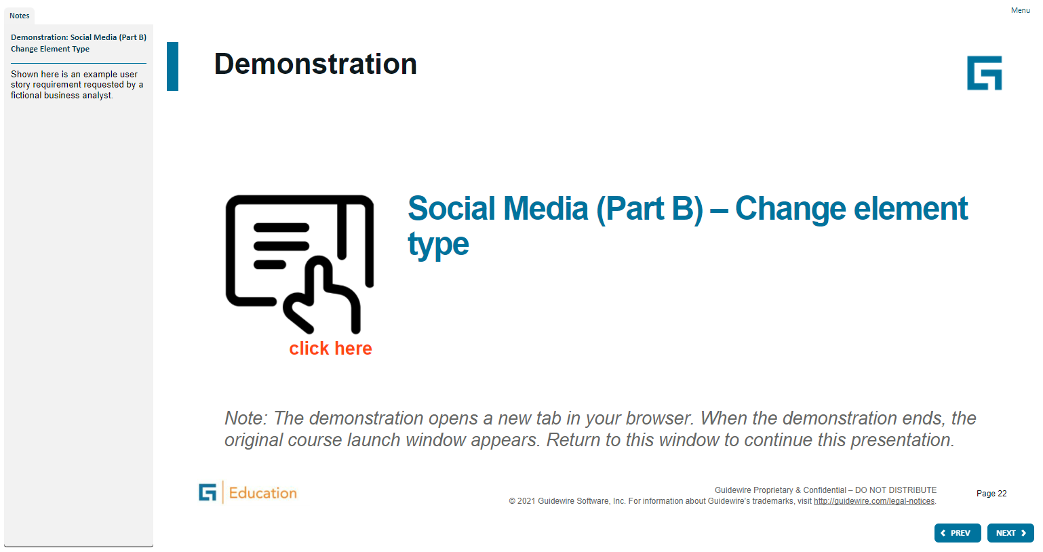
Notes:
A widget is a graphical user interface element responsible for interacting with the user. "Widget" is a Java specific, industry term. Widgets maintain and draw their state using some combination of graphical drawing operations. Using the mouse or the keyboard, the user can change the state of a widget. When a state change occurs, whether initiated by the user or the application code, widgets redraw to show the new state.
Both Widget and Location are conceptual representations in this diagram. There are no <Widget /> or <Location /> elements. Atomic Widget is also a conceptual representation. There is no <AtomicWidget /> element.
A location is a place to which you can navigate in the interface. Locations are used primarily to provide a hierarchical organization of the interface elements, and to assist with navigation. PCF elements that are consider locations include pages, wizards, worksheets, forwards, and location groups.
A widget is a PCF element that a Guidewire application renders into an HTML object. Buttons, menus, text boxes, and dropdown lists are all examples of PCF elements that are considered widgets. Some widgets that are not visually presented in the web browser, but are rendered as an HTML object, such as a hidden input.

Slide 23
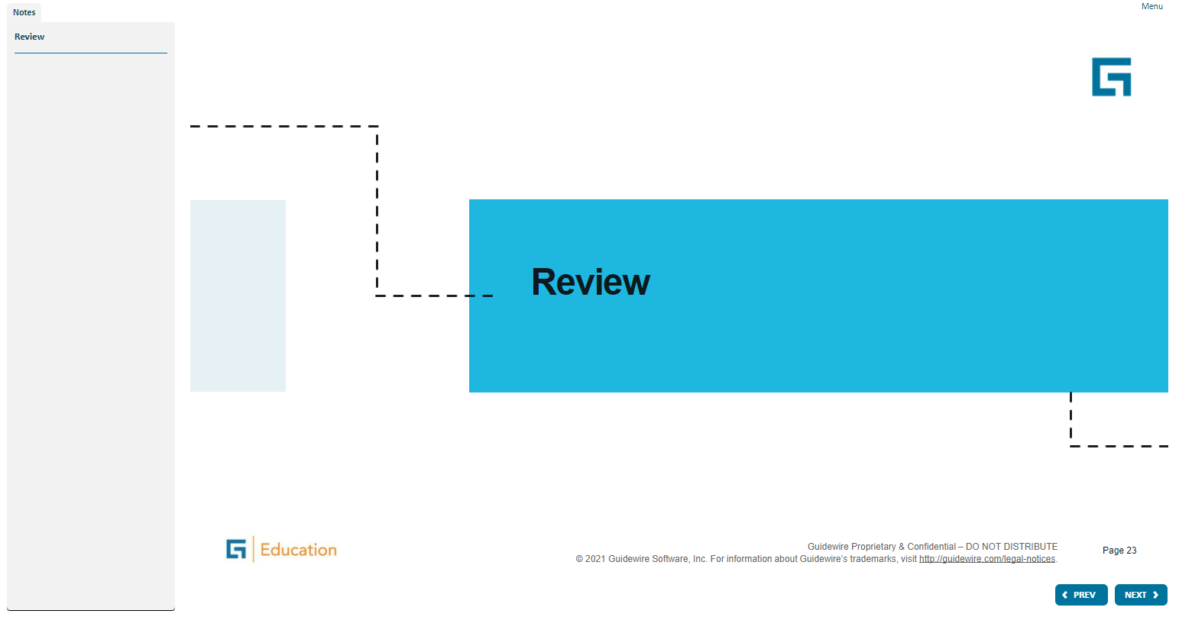
Notes:
A widget is a graphical user interface element responsible for interacting with the user. "Widget" is a Java specific, industry term. Widgets maintain and draw their state using some combination of graphical drawing operations. Using the mouse or the keyboard, the user can change the state of a widget. When a state change occurs, whether initiated by the user or the application code, widgets redraw to show the new state.
Both Widget and Location are conceptual representations in this diagram. There are no <Widget /> or <Location /> elements. Atomic Widget is also a conceptual representation. There is no <AtomicWidget /> element.
A location is a place to which you can navigate in the interface. Locations are used primarily to provide a hierarchical organization of the interface elements, and to assist with navigation. PCF elements that are consider locations include pages, wizards, worksheets, forwards, and location groups.
A widget is a PCF element that a Guidewire application renders into an HTML object. Buttons, menus, text boxes, and dropdown lists are all examples of PCF elements that are considered widgets. Some widgets that are not visually presented in the web browser, but are rendered as an HTML object, such as a hidden input.

Slide 24
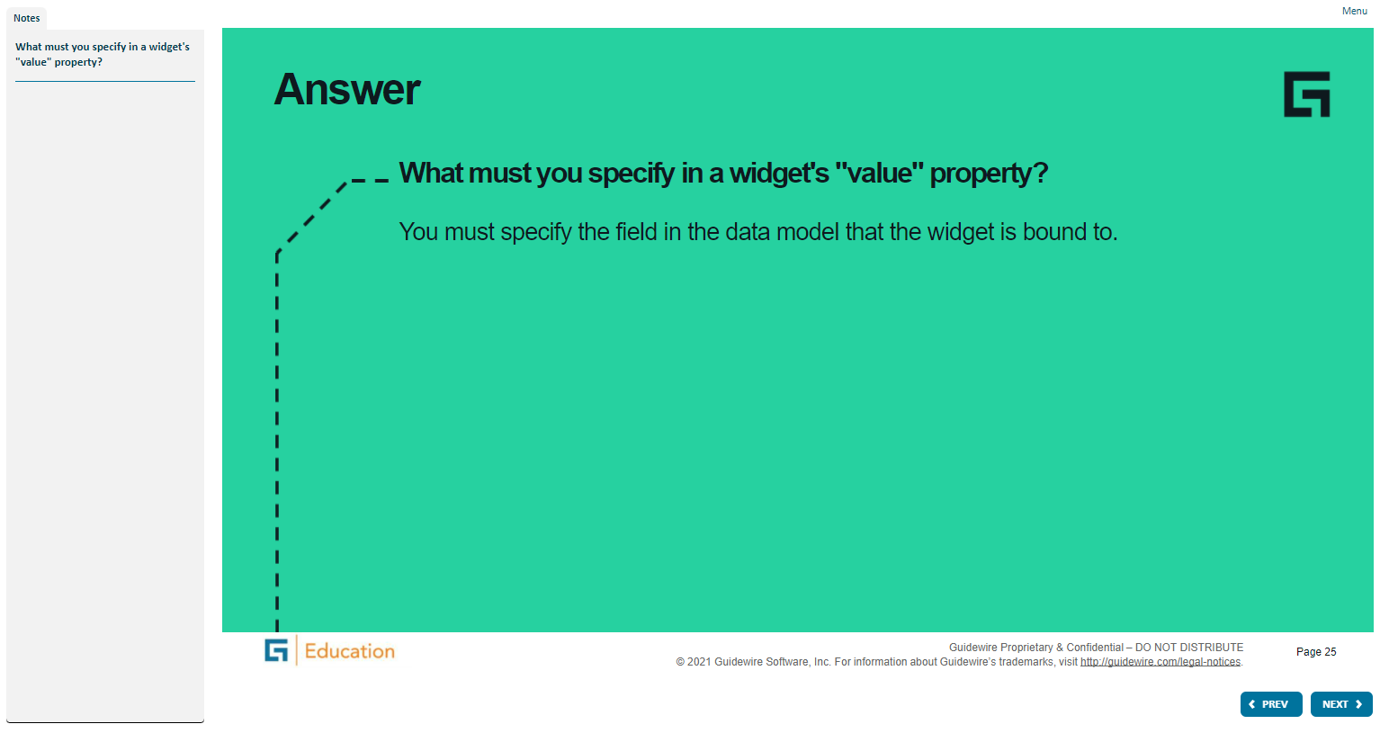
Notes:
A widget is a graphical user interface element responsible for interacting with the user. "Widget" is a Java specific, industry term. Widgets maintain and draw their state using some combination of graphical drawing operations. Using the mouse or the keyboard, the user can change the state of a widget. When a state change occurs, whether initiated by the user or the application code, widgets redraw to show the new state.
Both Widget and Location are conceptual representations in this diagram. There are no <Widget /> or <Location /> elements. Atomic Widget is also a conceptual representation. There is no <AtomicWidget /> element.
A location is a place to which you can navigate in the interface. Locations are used primarily to provide a hierarchical organization of the interface elements, and to assist with navigation. PCF elements that are consider locations include pages, wizards, worksheets, forwards, and location groups.
A widget is a PCF element that a Guidewire application renders into an HTML object. Buttons, menus, text boxes, and dropdown lists are all examples of PCF elements that are considered widgets. Some widgets that are not visually presented in the web browser, but are rendered as an HTML object, such as a hidden input.

Slide 25
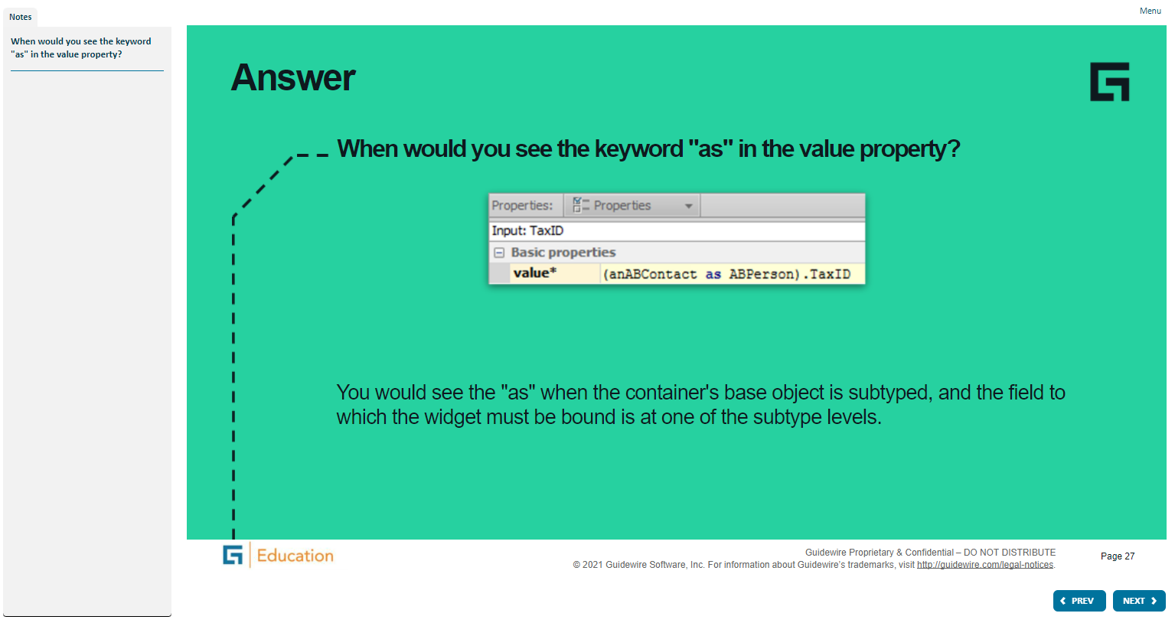
Notes:
A widget is a graphical user interface element responsible for interacting with the user. "Widget" is a Java specific, industry term. Widgets maintain and draw their state using some combination of graphical drawing operations. Using the mouse or the keyboard, the user can change the state of a widget. When a state change occurs, whether initiated by the user or the application code, widgets redraw to show the new state.
Both Widget and Location are conceptual representations in this diagram. There are no <Widget /> or <Location /> elements. Atomic Widget is also a conceptual representation. There is no <AtomicWidget /> element.
A location is a place to which you can navigate in the interface. Locations are used primarily to provide a hierarchical organization of the interface elements, and to assist with navigation. PCF elements that are consider locations include pages, wizards, worksheets, forwards, and location groups.
A widget is a PCF element that a Guidewire application renders into an HTML object. Buttons, menus, text boxes, and dropdown lists are all examples of PCF elements that are considered widgets. Some widgets that are not visually presented in the web browser, but are rendered as an HTML object, such as a hidden input.

Slide 26
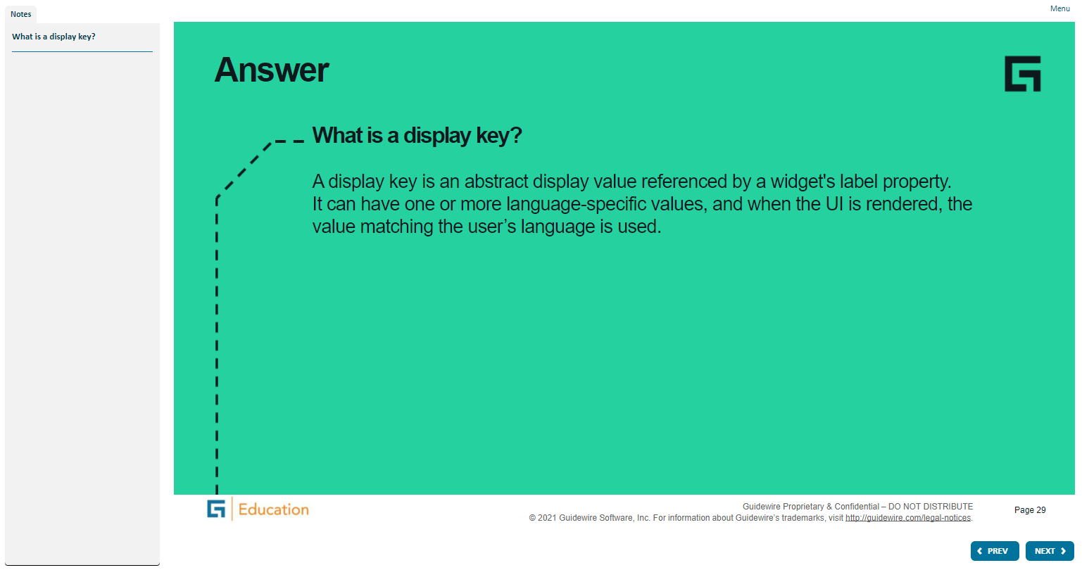
Notes:
A widget is a graphical user interface element responsible for interacting with the user. "Widget" is a Java specific, industry term. Widgets maintain and draw their state using some combination of graphical drawing operations. Using the mouse or the keyboard, the user can change the state of a widget. When a state change occurs, whether initiated by the user or the application code, widgets redraw to show the new state.
Both Widget and Location are conceptual representations in this diagram. There are no <Widget /> or <Location /> elements. Atomic Widget is also a conceptual representation. There is no <AtomicWidget /> element.
A location is a place to which you can navigate in the interface. Locations are used primarily to provide a hierarchical organization of the interface elements, and to assist with navigation. PCF elements that are consider locations include pages, wizards, worksheets, forwards, and location groups.
A widget is a PCF element that a Guidewire application renders into an HTML object. Buttons, menus, text boxes, and dropdown lists are all examples of PCF elements that are considered widgets. Some widgets that are not visually presented in the web browser, but are rendered as an HTML object, such as a hidden input.

Slide 27
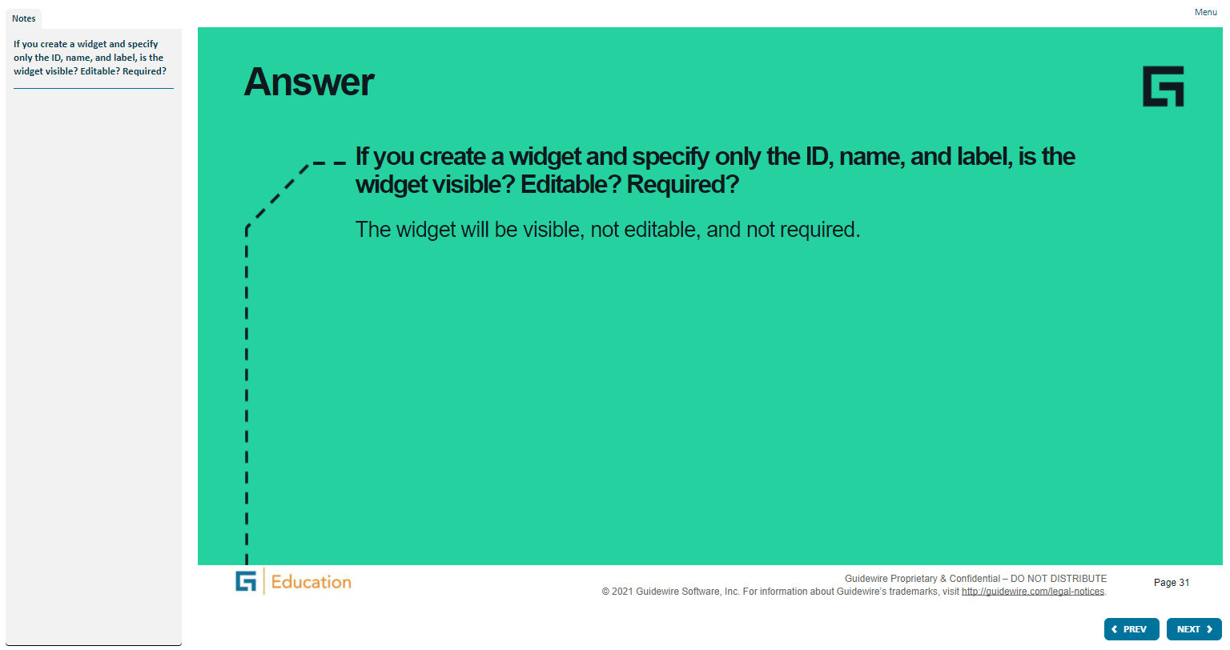
Notes:
A widget is a graphical user interface element responsible for interacting with the user. "Widget" is a Java specific, industry term. Widgets maintain and draw their state using some combination of graphical drawing operations. Using the mouse or the keyboard, the user can change the state of a widget. When a state change occurs, whether initiated by the user or the application code, widgets redraw to show the new state.
Both Widget and Location are conceptual representations in this diagram. There are no <Widget /> or <Location /> elements. Atomic Widget is also a conceptual representation. There is no <AtomicWidget /> element.
A location is a place to which you can navigate in the interface. Locations are used primarily to provide a hierarchical organization of the interface elements, and to assist with navigation. PCF elements that are consider locations include pages, wizards, worksheets, forwards, and location groups.
A widget is a PCF element that a Guidewire application renders into an HTML object. Buttons, menus, text boxes, and dropdown lists are all examples of PCF elements that are considered widgets. Some widgets that are not visually presented in the web browser, but are rendered as an HTML object, such as a hidden input.

Slide 28
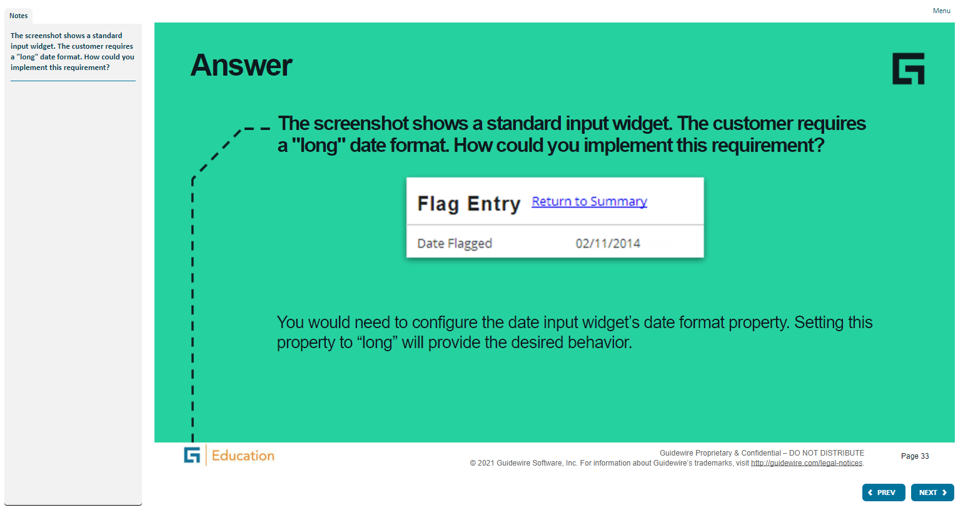
Notes:
A widget is a graphical user interface element responsible for interacting with the user. "Widget" is a Java specific, industry term. Widgets maintain and draw their state using some combination of graphical drawing operations. Using the mouse or the keyboard, the user can change the state of a widget. When a state change occurs, whether initiated by the user or the application code, widgets redraw to show the new state.
Both Widget and Location are conceptual representations in this diagram. There are no <Widget /> or <Location /> elements. Atomic Widget is also a conceptual representation. There is no <AtomicWidget /> element.
A location is a place to which you can navigate in the interface. Locations are used primarily to provide a hierarchical organization of the interface elements, and to assist with navigation. PCF elements that are consider locations include pages, wizards, worksheets, forwards, and location groups.
A widget is a PCF element that a Guidewire application renders into an HTML object. Buttons, menus, text boxes, and dropdown lists are all examples of PCF elements that are considered widgets. Some widgets that are not visually presented in the web browser, but are rendered as an HTML object, such as a hidden input.

Slide 29
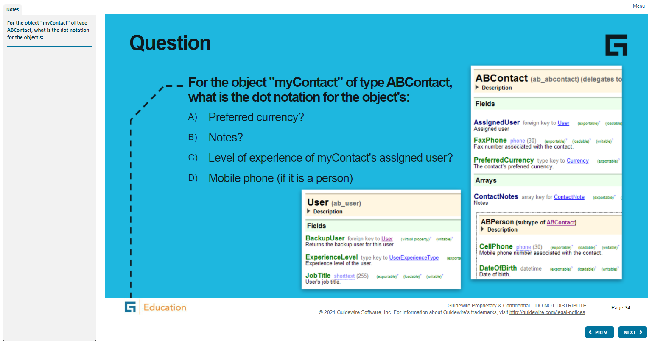
Notes:
A widget is a graphical user interface element responsible for interacting with the user. "Widget" is a Java specific, industry term. Widgets maintain and draw their state using some combination of graphical drawing operations. Using the mouse or the keyboard, the user can change the state of a widget. When a state change occurs, whether initiated by the user or the application code, widgets redraw to show the new state.
Both Widget and Location are conceptual representations in this diagram. There are no <Widget /> or <Location /> elements. Atomic Widget is also a conceptual representation. There is no <AtomicWidget /> element.
A location is a place to which you can navigate in the interface. Locations are used primarily to provide a hierarchical organization of the interface elements, and to assist with navigation. PCF elements that are consider locations include pages, wizards, worksheets, forwards, and location groups.
A widget is a PCF element that a Guidewire application renders into an HTML object. Buttons, menus, text boxes, and dropdown lists are all examples of PCF elements that are considered widgets. Some widgets that are not visually presented in the web browser, but are rendered as an HTML object, such as a hidden input.

Slide 30
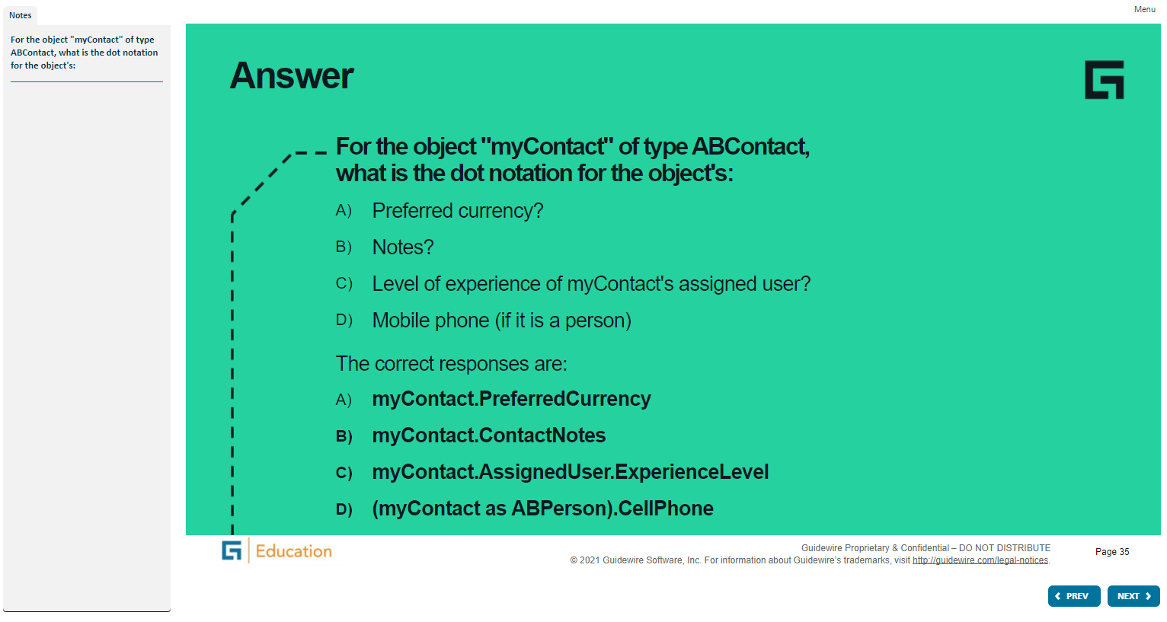
Notes:
A widget is a graphical user interface element responsible for interacting with the user. "Widget" is a Java specific, industry term. Widgets maintain and draw their state using some combination of graphical drawing operations. Using the mouse or the keyboard, the user can change the state of a widget. When a state change occurs, whether initiated by the user or the application code, widgets redraw to show the new state.
Both Widget and Location are conceptual representations in this diagram. There are no <Widget /> or <Location /> elements. Atomic Widget is also a conceptual representation. There is no <AtomicWidget /> element.
A location is a place to which you can navigate in the interface. Locations are used primarily to provide a hierarchical organization of the interface elements, and to assist with navigation. PCF elements that are consider locations include pages, wizards, worksheets, forwards, and location groups.
A widget is a PCF element that a Guidewire application renders into an HTML object. Buttons, menus, text boxes, and dropdown lists are all examples of PCF elements that are considered widgets. Some widgets that are not visually presented in the web browser, but are rendered as an HTML object, such as a hidden input.

Slide 31
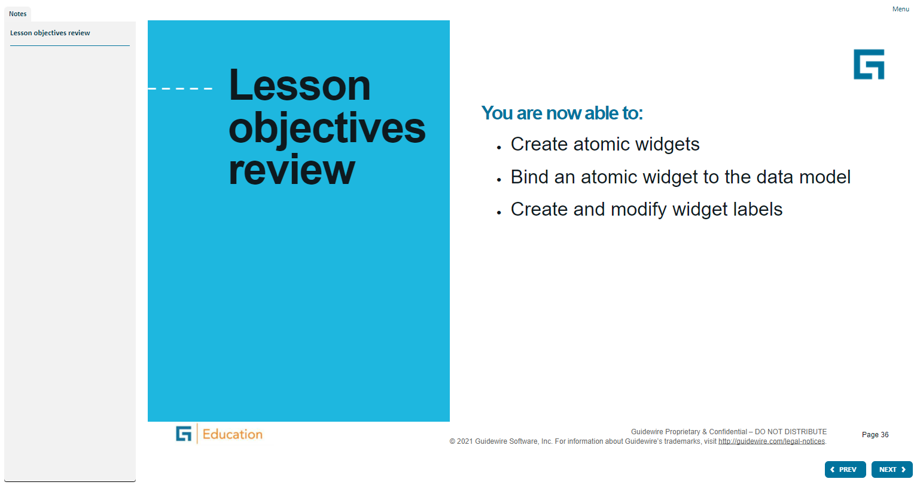
Notes:
A widget is a graphical user interface element responsible for interacting with the user. "Widget" is a Java specific, industry term. Widgets maintain and draw their state using some combination of graphical drawing operations. Using the mouse or the keyboard, the user can change the state of a widget. When a state change occurs, whether initiated by the user or the application code, widgets redraw to show the new state.
Both Widget and Location are conceptual representations in this diagram. There are no <Widget /> or <Location /> elements. Atomic Widget is also a conceptual representation. There is no <AtomicWidget /> element.
A location is a place to which you can navigate in the interface. Locations are used primarily to provide a hierarchical organization of the interface elements, and to assist with navigation. PCF elements that are consider locations include pages, wizards, worksheets, forwards, and location groups.
A widget is a PCF element that a Guidewire application renders into an HTML object. Buttons, menus, text boxes, and dropdown lists are all examples of PCF elements that are considered widgets. Some widgets that are not visually presented in the web browser, but are rendered as an HTML object, such as a hidden input.

Slide 32
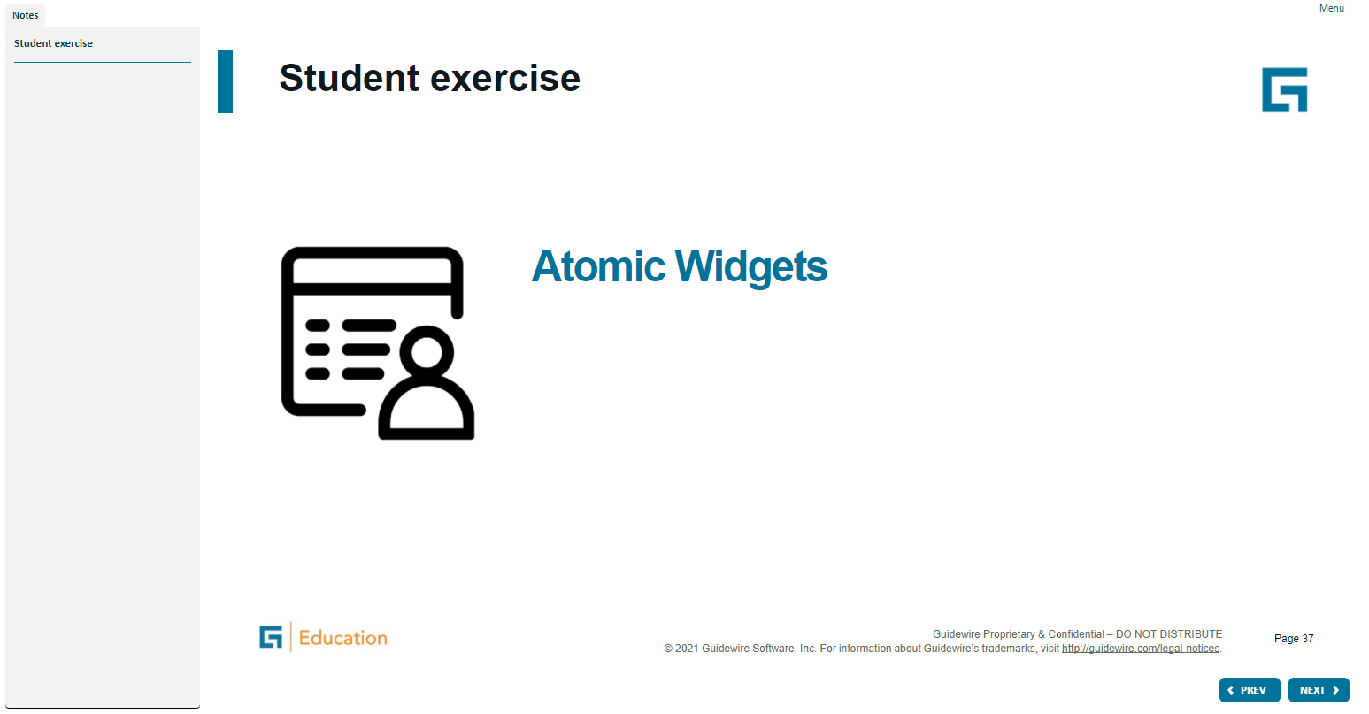
Notes:
A widget is a graphical user interface element responsible for interacting with the user. "Widget" is a Java specific, industry term. Widgets maintain and draw their state using some combination of graphical drawing operations. Using the mouse or the keyboard, the user can change the state of a widget. When a state change occurs, whether initiated by the user or the application code, widgets redraw to show the new state.
Both Widget and Location are conceptual representations in this diagram. There are no <Widget /> or <Location /> elements. Atomic Widget is also a conceptual representation. There is no <AtomicWidget /> element.
A location is a place to which you can navigate in the interface. Locations are used primarily to provide a hierarchical organization of the interface elements, and to assist with navigation. PCF elements that are consider locations include pages, wizards, worksheets, forwards, and location groups.
A widget is a PCF element that a Guidewire application renders into an HTML object. Buttons, menus, text boxes, and dropdown lists are all examples of PCF elements that are considered widgets. Some widgets that are not visually presented in the web browser, but are rendered as an HTML object, such as a hidden input.

